Slide 1
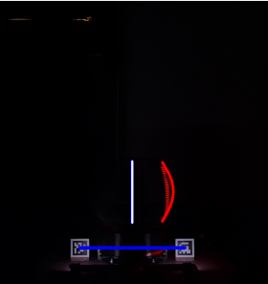
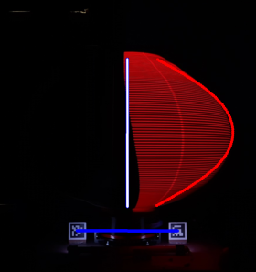
Unwrap the frame after camera calibration (camera matrix, distortion coefficients, rotation and translation vectors)
Compute a pixel-to-milimeter ratio after measuring the pixel size of each ArUco marker (47mm in the real world)
Draw the height of the display onto the frame using the pixel-to-milimeter ratio (200mm for 10H… 500mm for 25H)
The white bar is the height of the display
OK
(200mm)
NOT OK
(500mm) -> the white bar should always be larger than the red shape

